Slide 1

Department of Computer Science and Engineering
TG
BANGALORE
MINOR PROJECT
Personal Portfolio Website
Guide:
Mr.Likhith
Ankitha Acharya (TG02WD0265)

Slide 2
Abstract
Introduction
Objective
Problem Definition
Scope
Methodology
Experimental Setup
Results or Findings
Summary Table
Discussion
Proposed System
Feasibility Study
Workflow
Methods and Techniques Used
Progress in Project
Results
Conclusion
References

Slide 3
ABSTRACT
Personal portfolio website to showcase skills, projects, and achievements
Designed with a clean and responsive layout
Easy navigation across different devices
Reflects my learning journey and growth
Highlights practical experience in web development
Acts as a professional platform for opportunities

Slide 4
INTRODUCTION
A personal portfolio website to showcase my skills, projects, and achievements
Helps build a strong online professional presence
Designed with a simple, clean, and user-friendly interface
Includes sections like profile, skills, projects, and contact details
Developed using modern web technologies
Ensures responsive design for all devices
Reflects my learning journey and supports career opportunities

Slide 5
OBJECTIVE
The main objective of this project is to create a personal portfolio website that effectively showcases my skills, projects, and achievements. It aims to provide a clean, user-friendly, and responsive platform to present my work professionally and support future career opportunities

Slide 6
PROBLEM DEFINITION
Lack of a centralized platform to showcase skills and projects
Difficulty in presenting achievements in a professional way
Limited online visibility for career opportunities
Poor organization of personal and technical information
Need for a responsive and user-friendly portfolio website

Slide 7
SCOPE
Showcase skills and projects
Present information clearly
Ensure responsive design
Easy content updates
Support future enhancements

Slide 8
Methodology
Planning the structure and content of the portfolio
Designing a clean and user-friendly interface
Developing the website using HTML, CSS, and JavaScript
Integrating different sections like skills, projects, and contact
Testing for responsiveness and performance across devices
Making improvements based on testing results

Slide 9
Experimental Setup
Used personal data (skills, projects, achievements)
Developed using HTML, CSS, JavaScript
Tested on different browsers and devices
Checked responsiveness and performance
Deployed using Netlify
Verified all features and functionality

Slide 10
RESULTS / FINDINGS
Portfolio website is fully responsive across devices
Clean and simple design improves user experience
Easy navigation enables quick access to content
Well-structured layout enhances readability
Website performs smoothly with fast loading
Effectively showcases skills and projects

Slide 11
Summary Table
Feature | Description | Result
Skills Section | Displays technical skills | Clear presentation
Projects Section | Showcases project work | Easy understanding
Navigation | Menu for all sections | Smooth user experience
Design | Clean and modern UI | Attractive appearance
Responsiveness | Works on all devices | Better accessibility
Deployment | Hosted on Netlify | Live and accessible

Slide 12
DISCUSSION
The developed portfolio demonstrates an effective combination of design and functionality, ensuring a smooth user experience
The use of a clean and responsive layout improves accessibility across multiple devices
Structured presentation of content allows users to easily understand skills and project details
The project highlights the importance of personal branding in the digital era
Deployment on Netlify ensures real-time accessibility and performance
The system can be further enhanced by integrating advanced features such as animations, backend support, or dynamic content.

Slide 13
Proposed System
A personal portfolio website to showcase skills and projects
Provides a clean and responsive user interface
Organizes information in a structured manner
Enables easy navigation for users
Acts as a digital platform for professional visibility
Supports future enhancements and updates

Slide 14
FEASIBILITY STUDY
Technical Feasibility: Can be easily developed using HTML, CSS, and JavaScript with basic tools
Economic Feasibility: Low cost as it uses free tools and hosting like Netlify
Operational Feasibility: Easy to use and manage without complex maintenance
Time Feasibility: Can be developed within a short duration

Slide 15
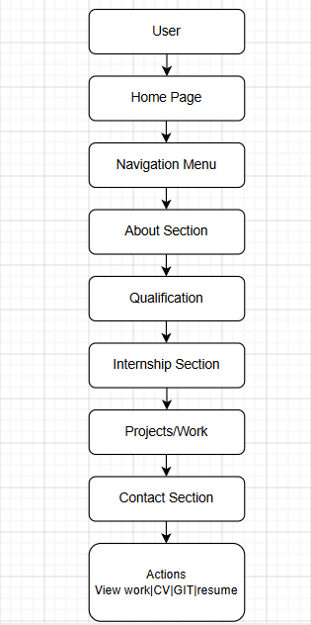
Workflow
Navigates through sections (Home, About, Skills, Projects, Contact)
Views personal details, skills, and project information
User opens the portfolio website
Interacts with buttons (View Work, GitHub, Download CV)
Accesses contact information for communication
Smooth flow ensures easy and efficient user experience

Slide 16
METHODS AND TECHNIQUES USED
Used HTML for structuring the website
Applied CSS for styling and layout design
Used JavaScript for basic interactivity
Implemented responsive design techniques for multi-device support
Followed UI/UX design principles for better user experience
Used modular section-based design (Home, About, Projects, Contact)
Deployed using Netlify for hosting and accessibility

Slide 17
PROGRESS IN PROJECT
Started by planning the layout and overall structure of the portfolio
Designed a simple and clean user interface for better experience
Developed different sections like About, Skills, Projects, and Contact
Added my personal details, skills, and project information
Tested the website on different devices to ensure responsiveness
Made improvements based on testing and feedback
Finally deployed the portfolio successfully on Netlify

Slide 18
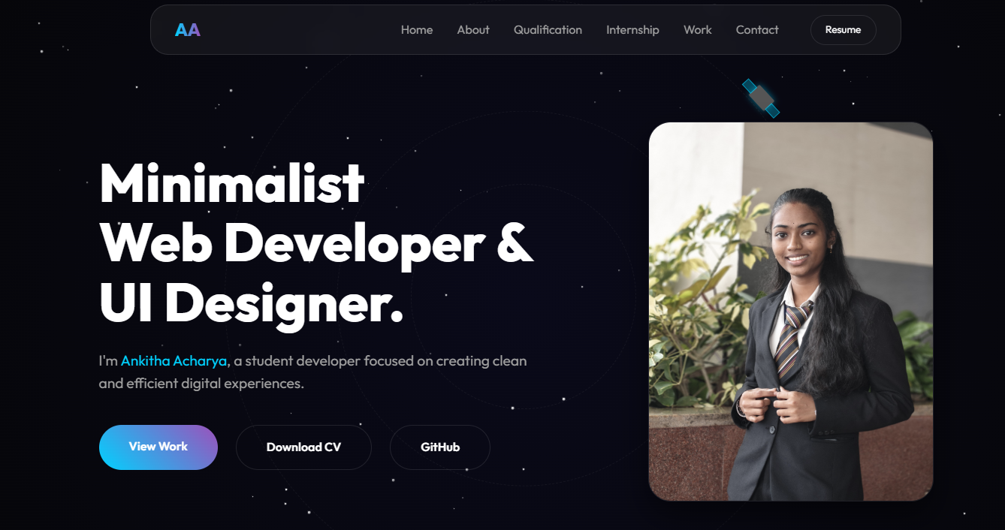
Results
Home Page

Slide 19
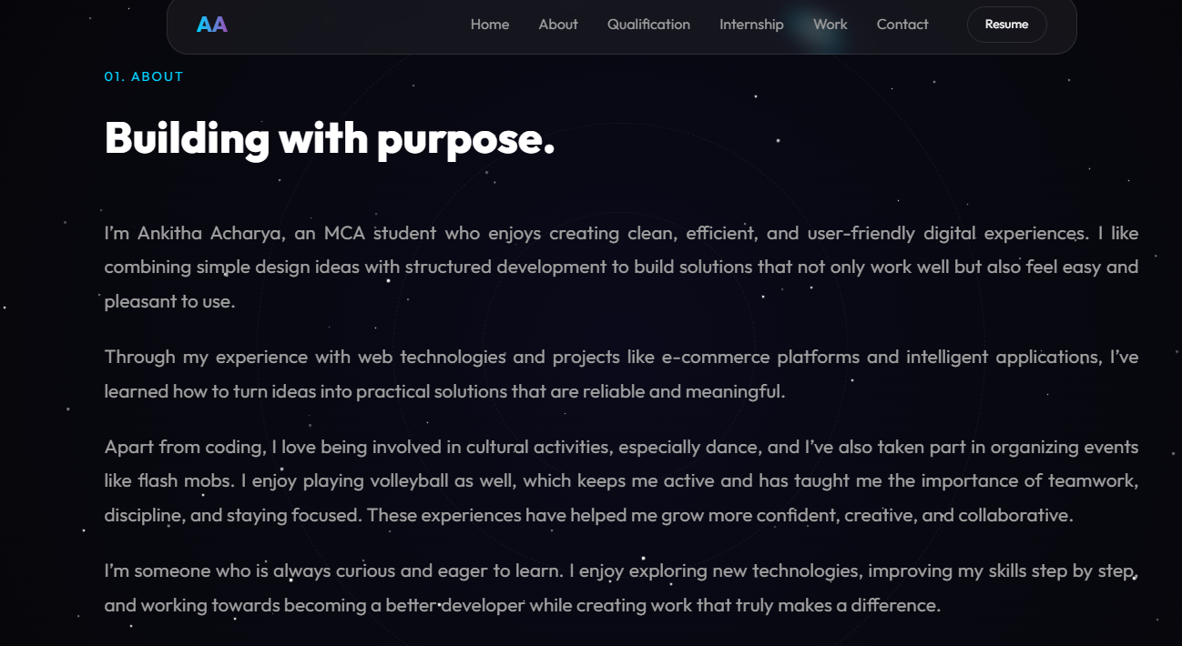
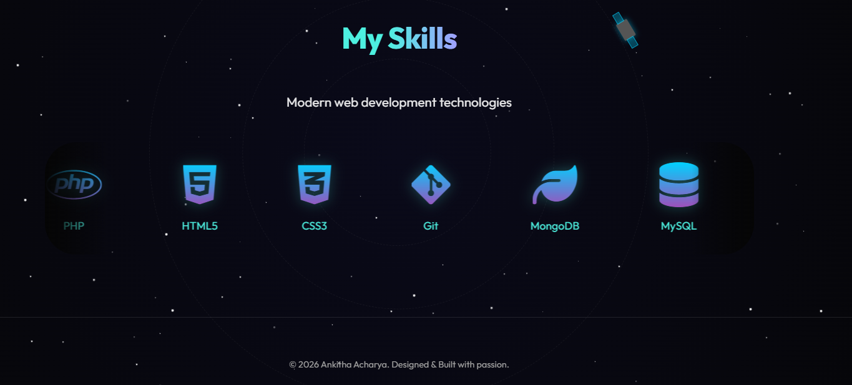
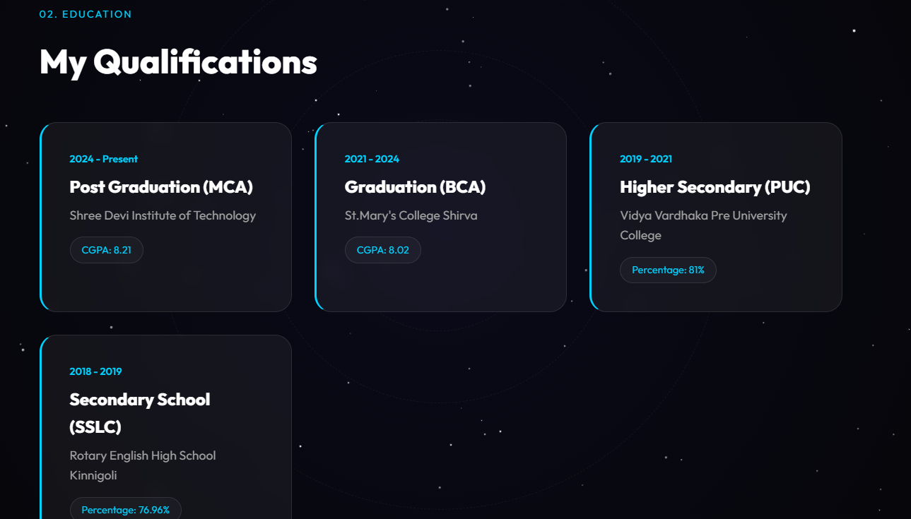
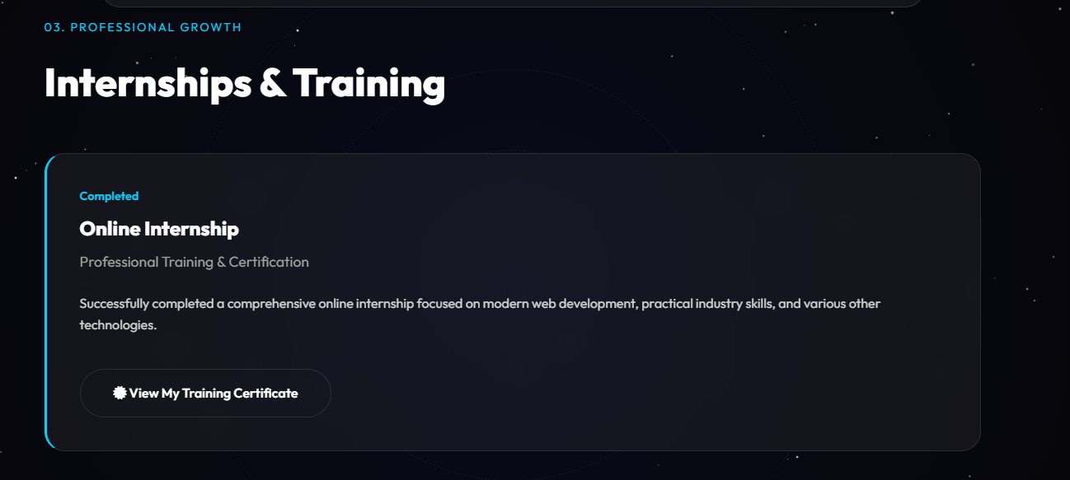
About Section
Skills
Qualification
Internship/Training

Slide 20
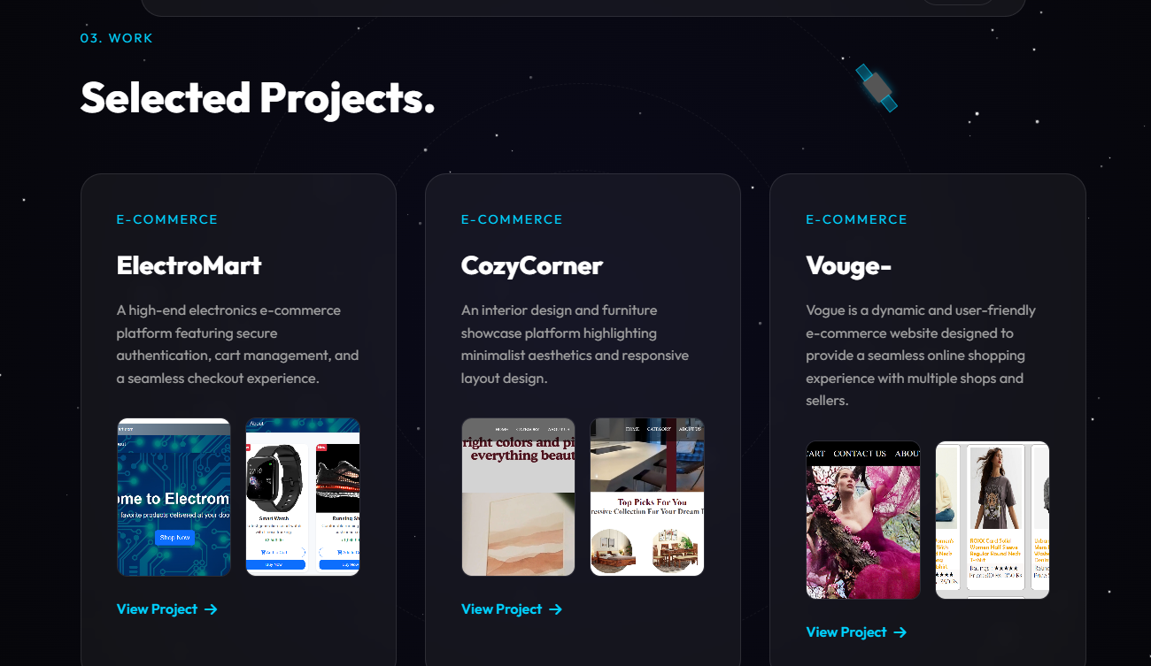
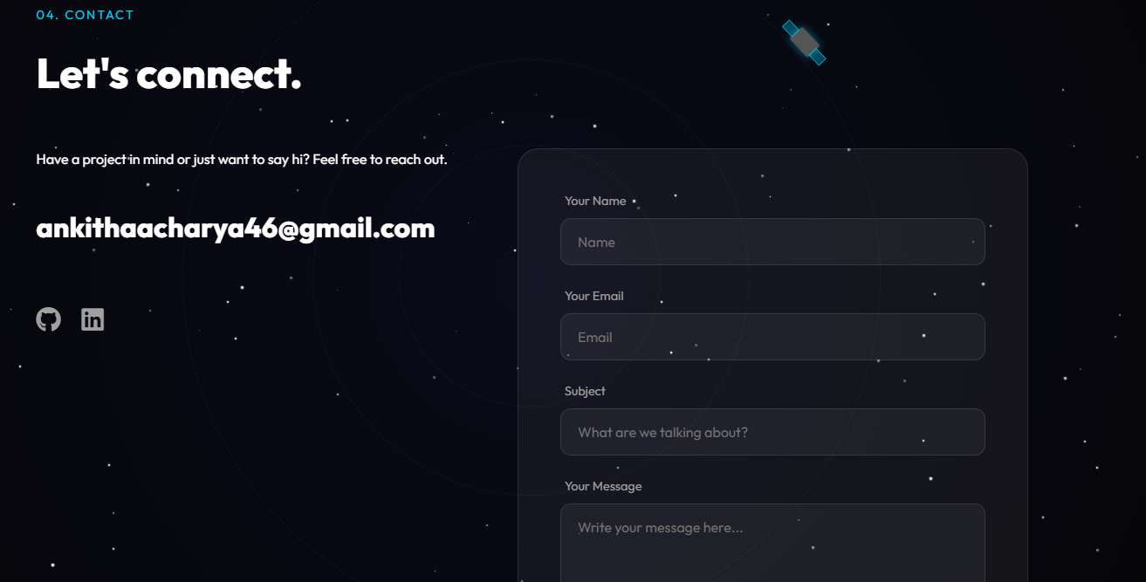
Projects
Contact
Link to visit:
https://mypersonal01portfoilo.netlify.app/

Slide 21
Conclusion
This project helped me build a personal portfolio to present my work in a clear and organized manner
I ws able to design a simple and responsive interface that works across different devices
It improved my practical understanding of web development concepts
The portfolio effectively reflects my skills, projects, and learning journey
Overall, it serves as a useful platform to present myself professionally and explore future opportunities

Slide 22
REFERENCES
W3Schools – Used to learn basic web development concepts
MDN Web Docs – Referred for understanding detailed topics and examples
Google Developers – Helped in learning responsive design techniques
Stack Overflow – Used to clarify doubts and fix coding issues

